Slide 1
Network Health Project
Notes:
https://docs.google.com/spreadsheets/d/1iEsypQXWgp128gJihGkT_8yGo-X1mE9kAme9kqctWK0/edit#gid=284074319

Slide 2
Agenda
1
Background
2
Objectives and Solution
3
Product Design
4
Tech Design
5
Network Quality Simulation

Slide 3


Background
Target Scene
SPX operators sometimes face slow system response, especially in high-volume operations like receiving, TO-packing.
Client
Server
RTT
Network Latency
Processing Latency
Send Request
Network
Server
API Performance
RTT
Processing Latency
Local IT
Dev
Receive Request
Network Latency

Slide 4
Background - Pain Point
Troubleshooting Process
Local always report such issue to Dev, and dev often takes a lot of effort investigating but often not being able to resolve.
Station Operator
Supervisor
PS Team
Dev
Pain Points
For Local: Inefficient problem handling；Unable to remove root cause.
For Dev: Difficult to investigate due to lack of real-time monitoring data.

Slide 5



Objectives and Solution
Objectives
Real-time feedback of network health to promote station network quality
Keep track and record station network status
Improve handling efficiency of long RTT issue by directing to corresponding assistance team
Monitor network performance to indicate whether offline-mode is worth building
Solution
Establish capability of real-time network health detection for key operations
Provide network diagnosis tool to track poor network issue
Weekly updates of station network health to Local & PM & Dev team
Notes:
看长期运行过程中的量化
offline module的必要性
除了Average <300ms，还需要花时间解决少数的慢查询问题
诊断结论暴露出来让用户报问题时候能提供有效问题信息
PC、PDA使用比例
跟BPM协商后续反馈机制，怎么将这个网络健康闭环掉。
考虑region维度增加基准线/P90，描述被Average平均掉的异常信息

Slide 6
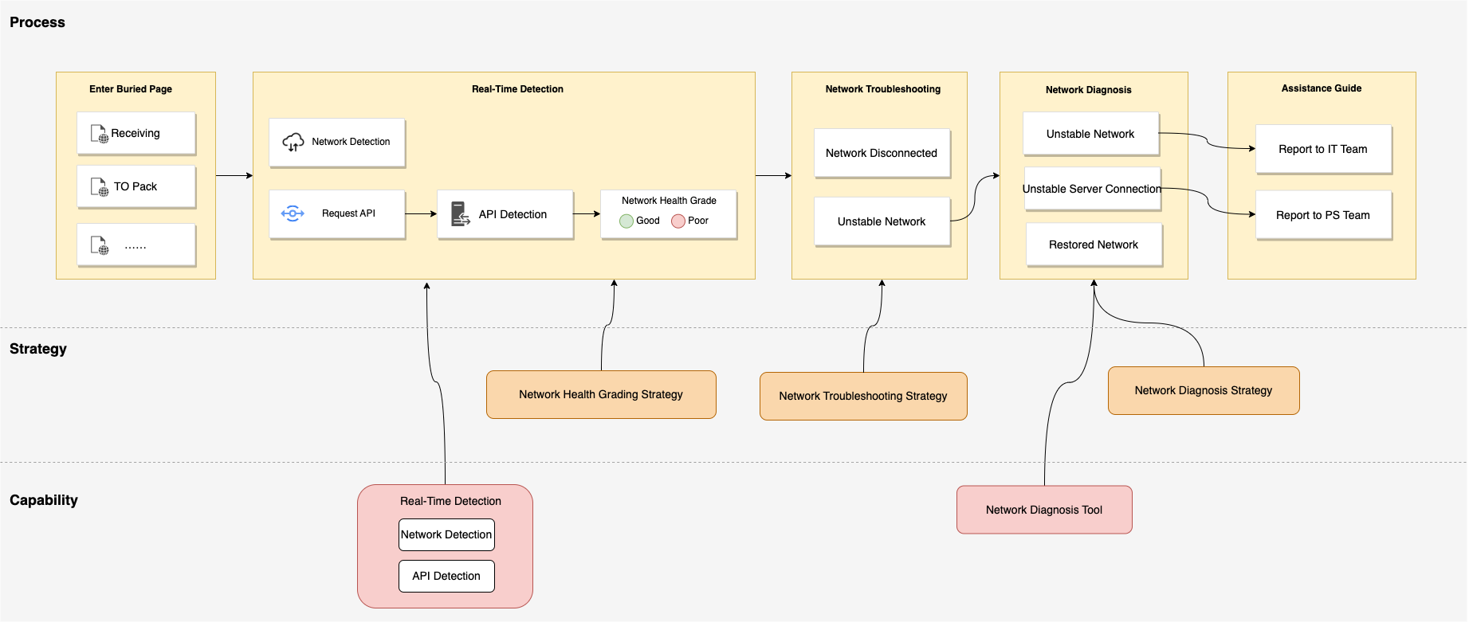
Product Design
Poor：Network Latency>=N s
Good：Network Latency<N s
N configurable, currently X=2
Poor Network accumulates X times in Y minutes
X/Y configurable, currently X=2, Y=2
More detail in next few pages

Slide 7
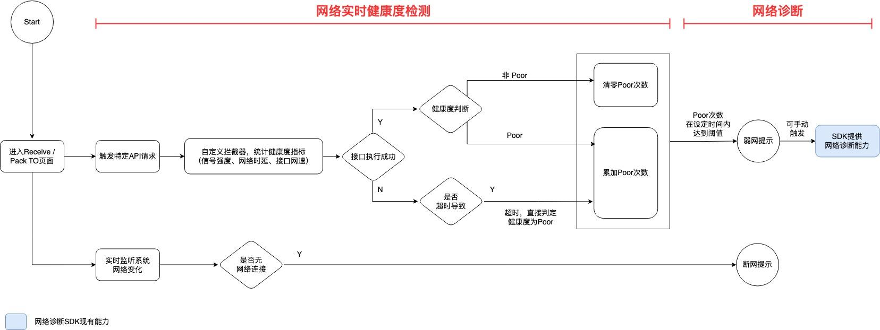
Tech Design- Main Flow
PC & PDA network health detection & network diagnosis flow

Slide 8
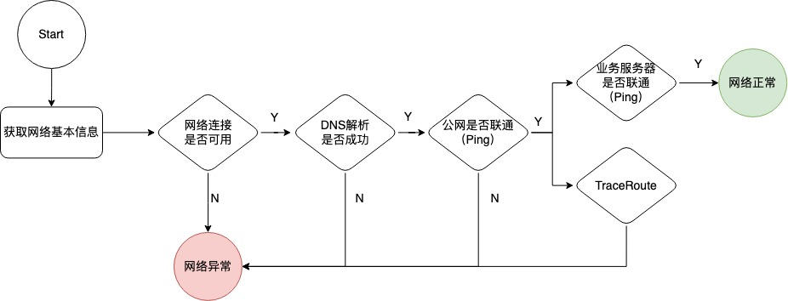
Tech Design - PDA Network Diagnosis Strategy
PDA Network diagnosis strategy
Diagnosis Task | Diagnosis Result | Hint
Network Connection | Unable to connect | Network is unstable, please reach out IT team for assistance.
DNS Resolution | Fail
Google Server Ping | Package loss rate > X% (X Configurable, X=10)
SPX Server Ping | Package loss rate > X% (X Configurable, X=10) | Server is unstable, please reach out PS team for assistance.
 | Package loss rate < X% (X Configurable, X=10) | Network is normal. Network restored, please carry on your operation.

Slide 9
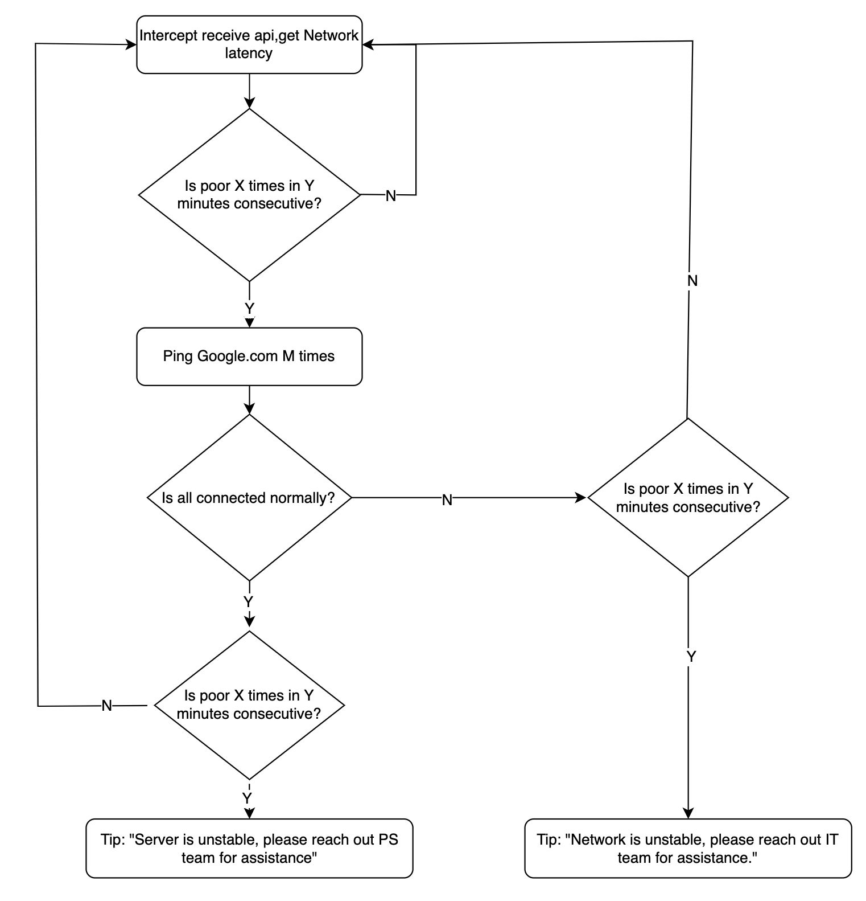
Tech Design - PC Network Diagnosis Strategy
Different from PDA, Web end lacks such multidimensional diagnosis tool.
Once detected unstable network, Web end will combine RTTs of pinging Internet and SPX server to determine whether it is a network problem or a server problem.

Slide 10
Appendix
PRD
PDA Tech Design
PC Tech Design
UI Design
Weekly Report of Station Network Health

Slide 11
Project Tracker
Early Nov 2022
Mid-Nov 2022
End Nov 2022
8 Dec 2022
21th Dec 2022
11th Jan 2023
Product Design
Tech Design
PRD Sign off
Test
PH Live Testing
Roll out to all regions
Current Stage
Based on previous feedback, PH was selected as the pilot region for live testing, which has been signed off.
BPM schedule to roll out to all regions on January 11.

Slide 12
Network Health Simulation
Objective
Experience different ranges of network latency to determine network health grading criteria.
Presentation
Operation Scene: Single Receive/ TO-Pack
Portal: PC & PDA
PIC of Presentation @junbo.wang @ xing.wu 演示说明0110

Slide 13
Conclusion
模拟体验结论：
看长期运行过程中的量化
offline module的必要性
除了Average <300ms，还需要花时间解决少数的慢查询问题
诊断结论暴露出来让用户报问题时候能提供有效问题信息
PC、PDA使用比例
跟BPM协商后续反馈机制，怎么将这个网络健康闭环掉。
考虑region维度增加基准线/P90，描述被Average平均掉的异常信息

